Slide 1



The Friends of Parkwood Surgery
Representative of all Patients * Enable Improvements * Support the Practice
Repeat Prescriptions Guide
How to set up your Patient Access account and
How to use the Patient Access website to manage your repeat prescriptions
https://friendsofparkwoodsurgery.com

Slide 2
The Friends of Parkwood Surgery
Requesting Repeat Prescriptions
From 01 March 2023, Parkwood Surgery will no longer accept email requests for repeat prescriptions whether submitted by you, or your nominated pharmacy.
This is because this method adds extra work for practice staff, and delays the processing of your request.
To make the repeat prescription request process more effective, patients should submit their requests through the Patient Access website – requests submitted this way go direct to a GP for approval.
What Do I Need To Do?
To be able to manage your repeat prescriptions going forwards you need to complete these steps:-
Step 1 – select two forms of ID, one with your photo
Step 2 – Request a Registration Letter
Step 3 – Register for a Patient Access account
Once complete, you will be able to manage your repeat prescription requests online.

Slide 3
The Friends of Parkwood Surgery
Step 1 – Select two forms of ID and create electronic copies
Acceptable forms of ID
One must be Photo ID – Driver’s Licence, Passport, Citizen Card or Bus Pass
The other must show your name and address – an official letter or household bill for example
Scan or photograph both items and save the files to the device you are using to complete Step 2.
E.g. Use your mobile phone to photograph the ID
If you do not have Photo ID - You can still register for Patient Access: take a Bank Card with your name on it and one other form of ID to the surgery: they will validate your identity and arrange a Registration Letter for you.
IMPORTANT! Make sure your details can be read clearly from the electronic image files

Slide 4
The Friends of Parkwood Surgery
Step 2 – Request a Registration Letter from Parkwood Surgery
On your PC or mobile phone, go to https://parkwoodsurgery.nhs.uk
Using the menu across the top of the page, select Forms
Then from the drop-down list select Register for Online Services
See next page for an image showing where to click
IMPORTANT! Don’t click the Online Services button on the home page

Slide 5
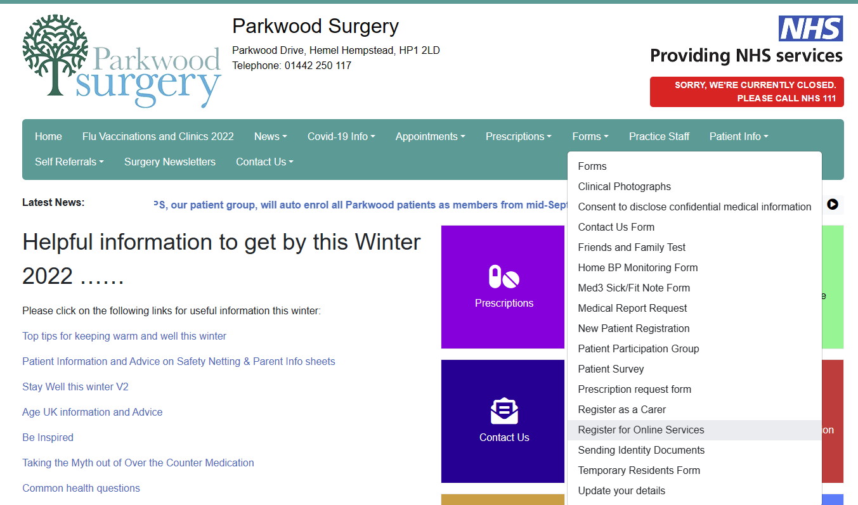
The Friends of Parkwood Surgery

Slide 6
The Friends of Parkwood Surgery
Step 2 – Request a Registration Letter from Parkwood Surgery, continued
Complete the online form with your details
First Name, Last Name
Date of Birth
Address, including Postcode
Phone Number
Email Address, and confirm email address
Read the Consent statement and tick the box
See next page for an image showing the fields to complete
IMPORTANT! Make sure your details can be read clearly from the image files

Slide 7
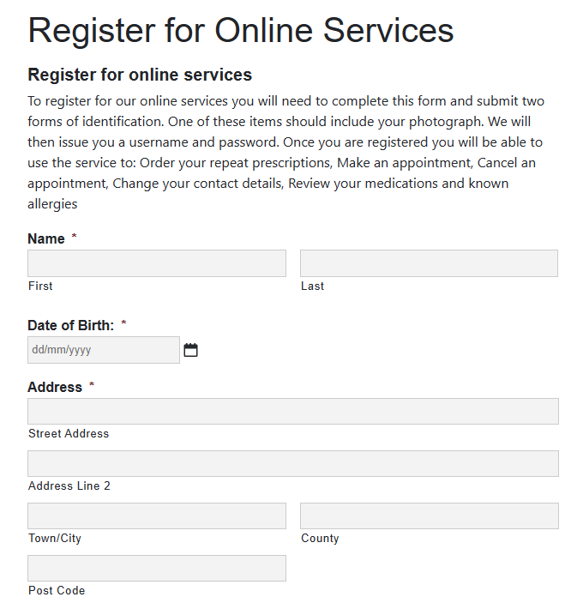
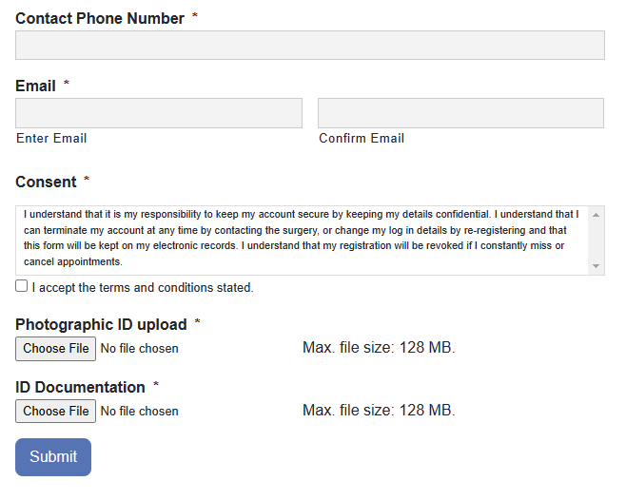
The Friends of Parkwood Surgery

Slide 8
The Friends of Parkwood Surgery
Step 2 – Request a Registration Letter from Parkwood Surgery, continued
Upload your ID files
For each image, click the Upload button, navigate to the folder and select the file
Confirm all information is correct, and press Submit
Please allow 2-3 days for the Surgery to process your request
The Surgery will ask you to collect the Registration Letter in person – take your Photo ID.
IMPORTANT! The Registration Letter will contain the code you need for Step 3.

Slide 9
The Friends of Parkwood Surgery
Step 3 – Register for a Patient Access account
In your web browser type https://www.patientaccess.com
Select Register
On the following screens, enter your personal details, and account details
Add a mobile phone number
Accept the Terms and Conditions
Select Create Account
Select Verify my email address: an email is sent to the address you defined
Open the email, click on Verify my email address
IMPORTANT! Adding your mobile phone number helps you recover access if you forget your Patient Access Password

Slide 10
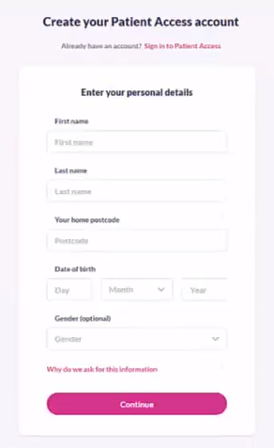
The Friends of Parkwood Surgery
Enter your first name and last name
Enter your postcode then select your address
Enter your Date of Birth
Click Continue

Slide 11
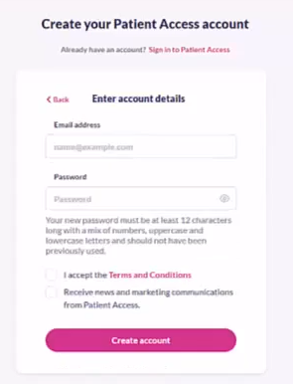
The Friends of Parkwood Surgery
On the next screen, enter your email address and a password – you will use these to logon to Patient Access
Accept the Terms & Conditions
Click Create Account

Slide 12
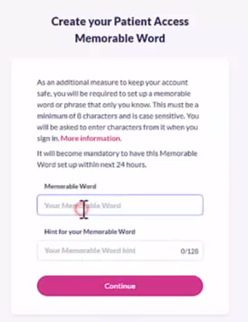
The Friends of Parkwood Surgery
Create a Memorable Word
This is extra security on your account to make sure others cannot logon
Enter your memorable word, then enter a hint – if you forget your memorable word the hint will be presented on screen to help you remember it
Click Continue

Slide 13
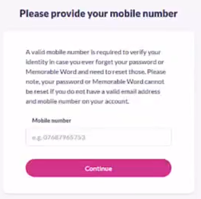
The Friends of Parkwood Surgery
Enter your mobile phone number
Whilst this isn’t mandatory, it makes it easier to reset your password if you forget your password in the future.
Enter your mobile phone number
Click Continue

Slide 14
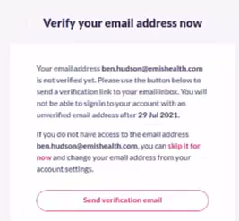
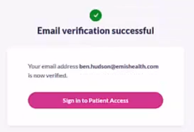
The Friends of Parkwood Surgery
Click the Send Verification Email button
This will send an email to the email address you defined
Open the email, then click on Verify
Once complete, the Email verification successful message appears on screen
Click Sign In to Patient Access

Slide 15
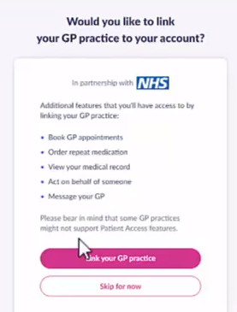
The Friends of Parkwood Surgery
On the next screen, click Link your GP practice
You must complete this step to be able to request repeat medication

Slide 16
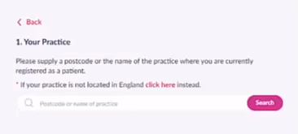
The Friends of Parkwood Surgery
On the next screen, type in HP1 2LD
This is the postcode for Parkwood Surgery
The website will now list local surgeries
Select Parkwood Surgery from the list

Slide 17
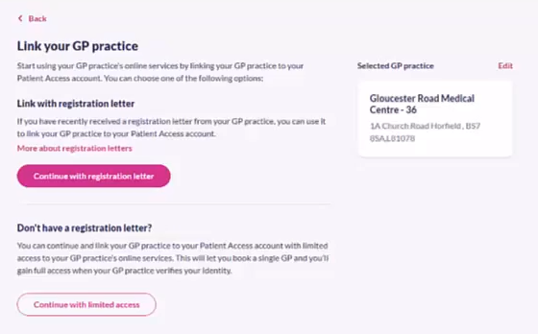
The Friends of Parkwood Surgery
On the next screen,
click on Continue with registration letter
Parkwood Surgery, Parkwood Drive, Hemel Hempstead, HP1 2LD

Slide 18
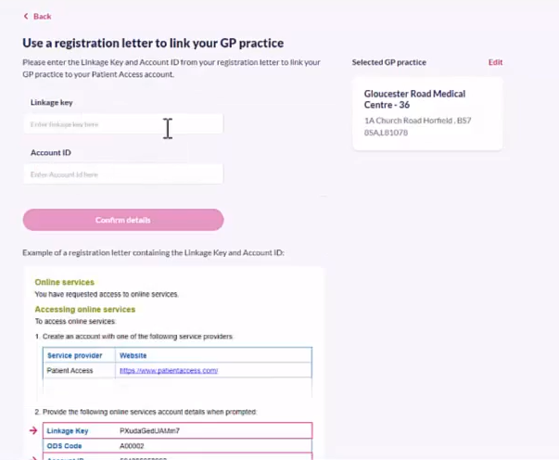
The Friends of Parkwood Surgery
On the Registration Letter from Parkwood Surgery, locate the codes for Patient Access
Enter the required codes on screen
Click Confirm details
Parkwood Surgery, Parkwood Drive, Hemel Hempstead, HP1 2LD

Slide 19
The Friends of Parkwood Surgery
Once your Patient Access account has been set up, and you have linked to Parkwood Surgery,
you can –
Logon to view your repeat medication items
See when medication was last requested
See when you can submit your next repeat medication request for each item.
Keep your Patient Access account details safe.
You will also be able to see your medical appointments, test results and more
IMPORTANT! You cannot book appointments through Patient Access (yet)

Slide 20
The Friends of Parkwood Surgery
To request a repeat prescription
In your web browser type https://www.patientaccess.com
Sign in using your email address and password
You will then be prompted to enter specific letters from your memorable word
In this example, let’s say our memorable word is memorableword101
If asked for the 4th character, 10th character and 14th character, you would enter o then w then 1
memorableword101
4th character = o
10th character = w
14th character = 1

Slide 21
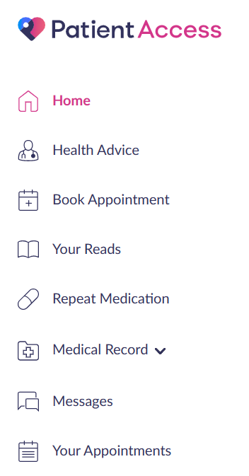
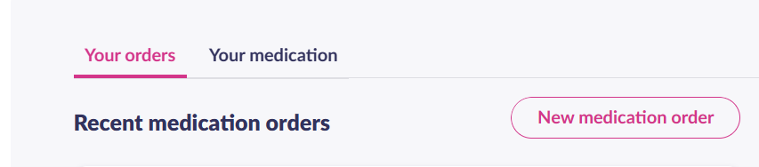
The Friends of Parkwood Surgery
From the menu, select Repeat Medication
Click New medication order
You will now see all items on your repeat form: each will show when it was last ordered, and when the next issue is due

Slide 22
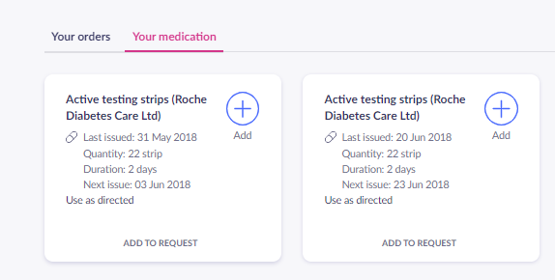
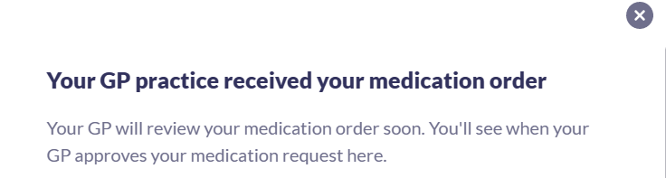
The Friends of Parkwood Surgery
For each item you require
click Add to Request or the + icon
Click Request Medication - it will show the number of items you selected
Check you have selected the correct items, then
Click Order Medication
You will see a message confirming that your request has been submitted to Parkwood Surgery. A GP will review and process your request, which will be sent directly to your nominated pharmacy.

Slide 23




The Friends of Parkwood Surgery
We hope you found this guide helpful.
We would be keen to hear about your experience setting up your account and requesting medication via Patient Access.
For more information about FPS, wo we are and what we do, please visit our website, or follow us on social media.
friendsofparkwooddrive@gmail.com
@FriendsofParkwoodSurgery
https://friendsofparkwoodsurgery.com
@ParkwoodFriends
Representative of all Patients * Enable Improvements * Support the Practice

